Slide 1





The Web Conference 2021
Demystifying Illegal Mobile Gambling Apps
Yuhao Gao
Beijing University of Posts
and Telecommunications
Haoyu Wang
Beijing University of Posts
and Telecommunications
Li Li
Monash University
Xiapu Luo
The Hong Kong Polytechnic
University
Guoai Xu
Beijing University of Posts
and Telecommunications
Xuanzhe Liu
Peking University
Notes:
Hello, everyone,
I’m Yuhao Gao, PhD candidate from Beijing University of Posts and telecommunications.
Today, I’m presenting the work done with my co-authors from
Beijing University of Posts and telecommunications,
Monash University,
The Hong Kong Polytechnic University,
and Peking University.
Our work focuses on Demystifying Illegal Mobile Gambling Apps.

Slide 2
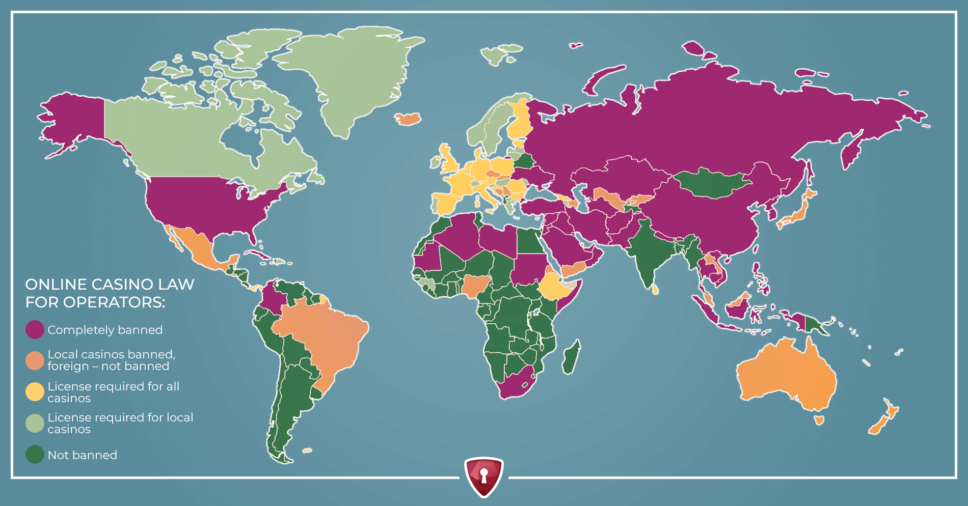
Illegal Gambling Apps
In most countries gambling are under strict regulations
* WHERE IS ONLINE GAMBLING LEGAL IN 2021? https://slotegrator.pro/gambling_blog/where-online-gambling-is-legal.html
Notes:
This figure shown the online casino law for operators, as you can see that only a few countries are green which means gambling are not banned. In most other countries gambling are under strict regulations, even completely banned in countries with purple color.

Slide 3
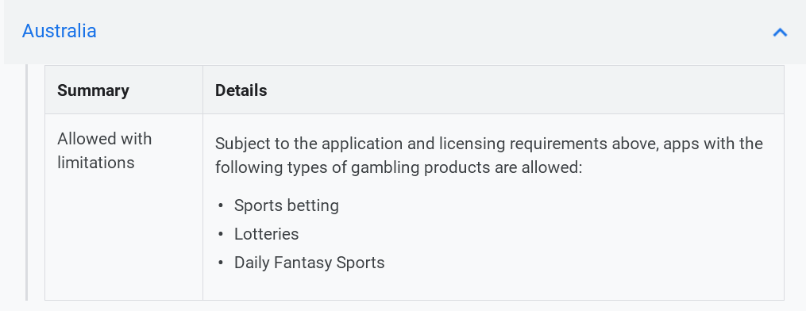
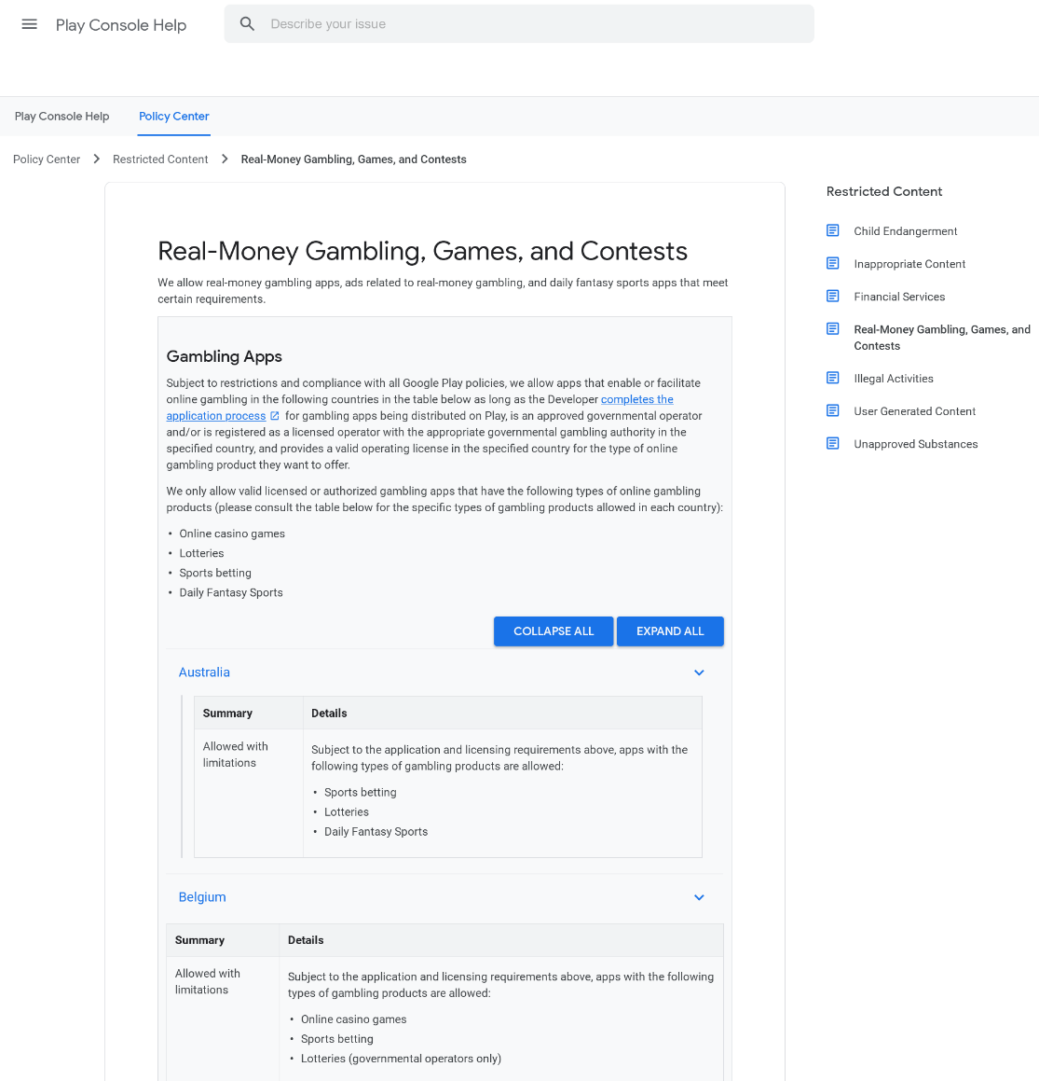
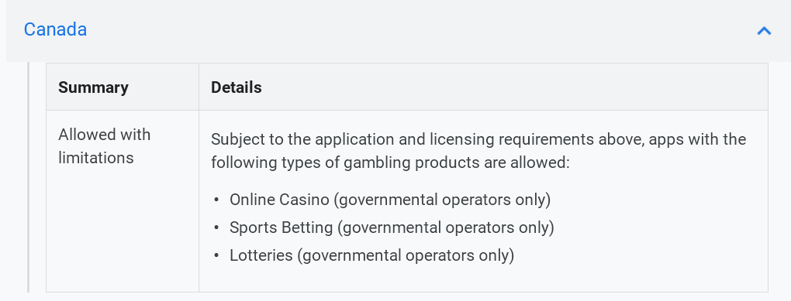
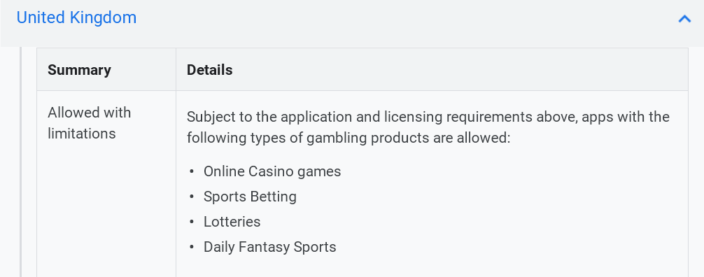
Illegal Gambling Apps
In app markets, gambling apps are under strict regulations
* Real-Money Gambling, Games, and Contests https://support.google.com/googleplay/android-developer/answer/9877032
Notes:
This is the gambling policy page of Google Play, according to it, gambling apps are only permitted in several countries, although in these countries, gambling apps are allowed with strict conditions.

Slide 4

Illegal Gambling Apps
are different from other apps?
Gambling Apps
How
Notes:
So, under strict regulations, how gambling apps are different from other apps?

Slide 5
Gambling App Ecosystem
Notes:
To understand the ecosystem of illegal gambling apps, we first conduct a preliminary study to understand the major players of them.
The first part is the corresponding gambling websites, where you can download gambling apps.
Besides, there are also some unique distribution platforms for downloading.
As for the developers, they usually create a number of gambling apps with templates, which connected to different web servers, because their servers would be blocked from time to time.
In addition, many third-party services like payment services are also widely used.

Slide 6
Research Questions
01
To what extent are gambling apps distributed in the wild, and how are they penetrated?
02
What are the characteristics of gambling apps?
03
Can we infer the underground campaigns behind illegal gambling apps so as to uncover more of such apps?
Notes:
To understand the ecosystem of gambling apps better and characterize them. Our study is driven by the following research questions.

Slide 7
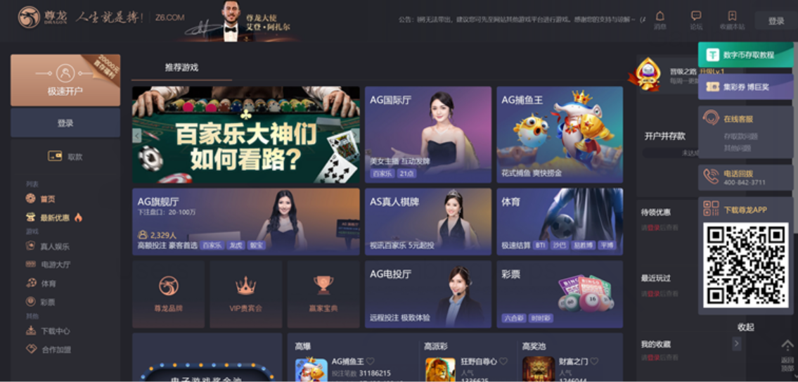

Dataset Collection
Identifying illegal online gambling websites
Download illegal gambling apps
Notes:
At first, let’s collect some gambling apps.
As we said, illegal gambling apps can be download from the corresponding websites.
So, we designed an effective method to download them from gambling websites. It contains two steps: identifying illegal online gambling websites and then, download apps.

Slide 8








Dataset Collection
ISP
DNS Data
Domains
Filtering
Crawling
Webpages
Content
Filtering
SVM
Gambling
Websites
Downloading
Gambling
Apps
Overview of the gambling app dataset
#Item | Count
Illegal Gambling sites | 6105
Distribution channels | 1415
Gambling apps | 3366
Gambling apks | 5344
Developer certificates | 1136
None of gambling apps was found in AndroZoo which contains over 10 million apps crawled from Google Play and several third-party app markets.
ICP Licenses
Alexa Top List
Notes:
To get more gambling websites, we obtain the DNS data from a major ISP in China.
With these data, firstly, we filtered irrelevant domains using the ICP licenses and Alexa top sites.
Then, we crawled the remaining domains. After filtering them by keywords, we used an SVM classifier identify illegal gambling websites.
Finally, we downloaded apps from them.
This table shows an overview of our dataset. None of the them are in AndroZoo, which contains over 10 million apps from Google Play and third-party markets.

Slide 9
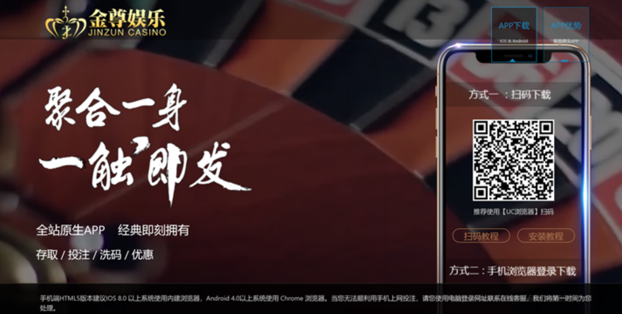

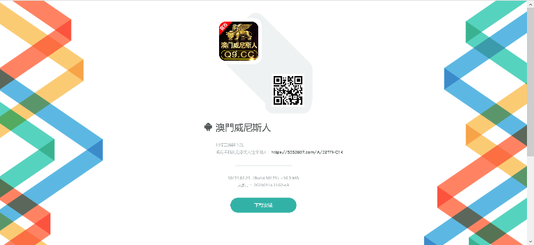
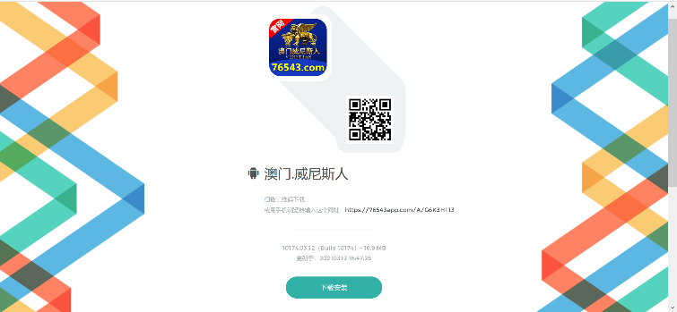
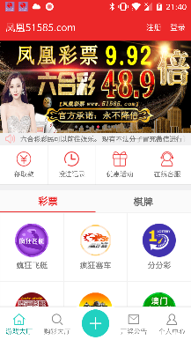
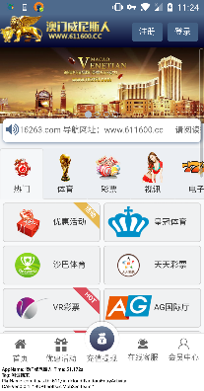
Distributing Gambling Apps
Gambling Websites
Users
Gambling Apps
Download Websites
Notes:
So, how could these apps be distributed?
In fact, different from ordinary apps distributed via markets, gambling apps use hidden download websites. Besides illegal gambling websites, You can also download gambling apps from them.

Slide 10
Distributing Gambling Apps
Type-1 Download services: use the same domains with gambling websites
Type-2 Download services: have their own domains
Domain | Gambling Websites | Apks | Unique Apks | Developers
yb9.me | 954 | 839 | 650 | 8
asd2159.ucc-bundle.broadcast-large.com | 223 | 124 | 112 | 7
yt9.me | 200 | 191 | 182 | 1
yk7.me | 150 | 125 | 104 | 3
app3.ppbk9.com | 136 | 91 | 60 | 2
Gambling websites, download services and gambling apps are highly related
Some top download services contains so many apps
Notes:
We classified these websites into two types, type-1 and type-2.
According to their domains, we defined type-1 use the same domains as illegal gambling websites, type-2 have their own domains.
As this relation graph and the table shown, some app and website nodes are pretty dense, suggesting that they are highly related.
And the top distribution channels have a lot of gambling apps.

Slide 11

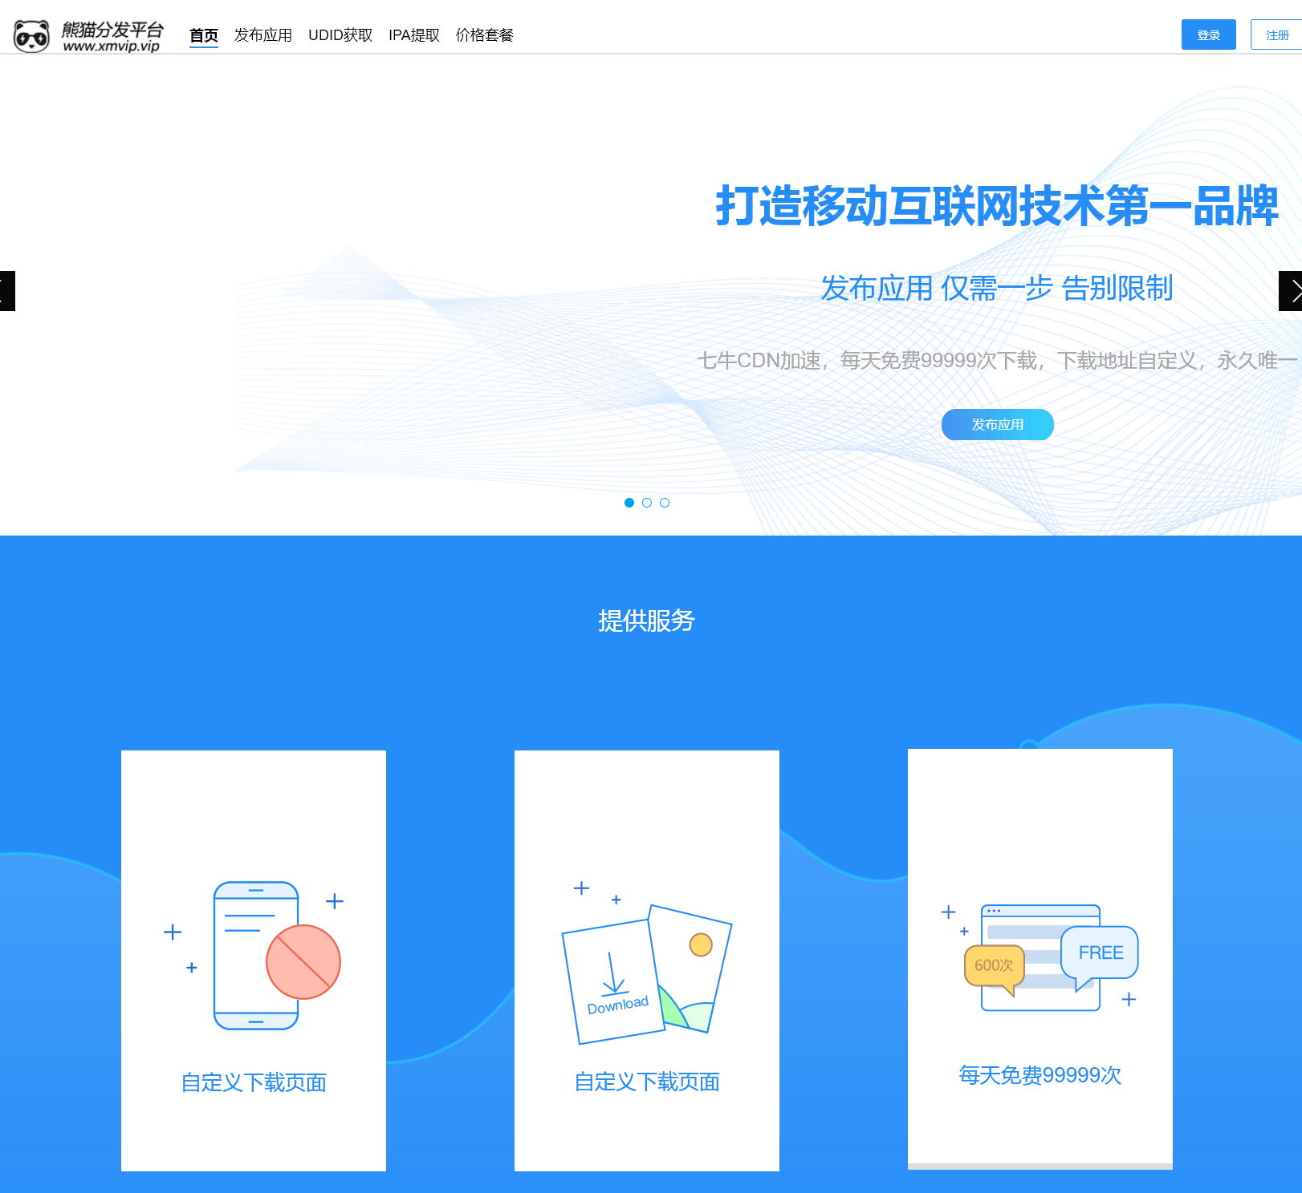
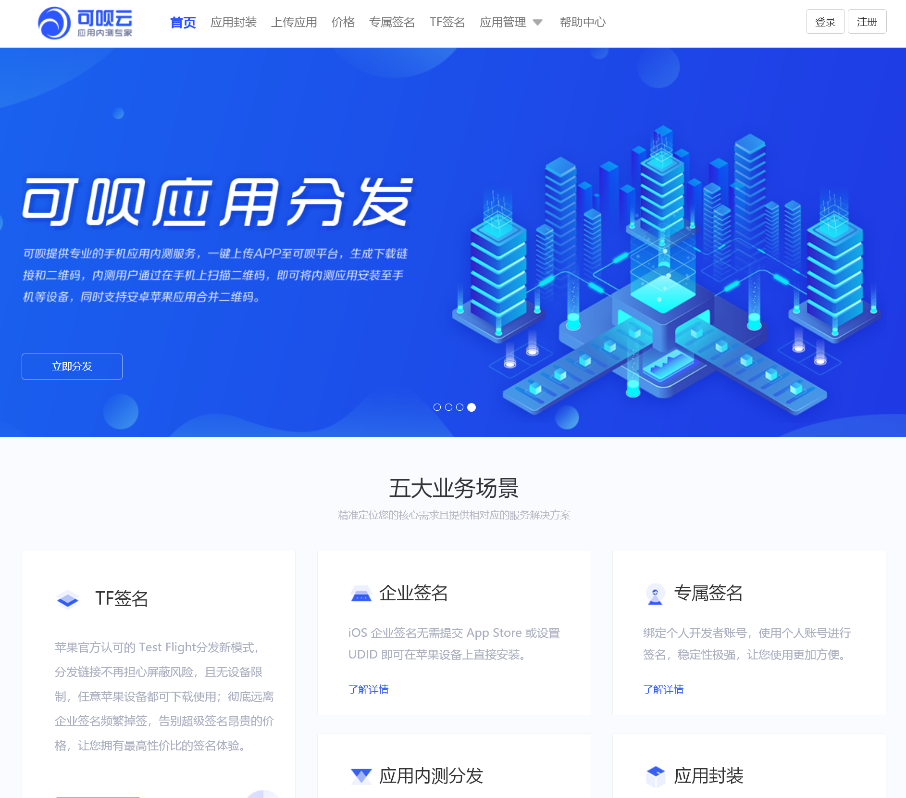
Distributing Gambling Apps
Abusing third-party app distribution channels
Download Websites
Crawling
Webpages
Many common third-party app distribution channels are abused by gambling apps
Notes:
In these websites, we noticed that some third-party app distribution channels are abused by gambling apps.
So we crawled all these download websites and manually analyzed them, we found that over fifty download services are common services, which can be used by any apps. They are used by more than 400 illegal gambling apps.

Slide 12
Characterizing Gambling Apps
Network Infrastructure
Third-party Services
01
03
02
04
Malicious Behaviors
Payment Services
Notes:
Next, let’s characterizing Gambling Apps. We analyzed them from 4 perspectives: Network Infrastructure, Malicious Behaviors, Third-party Services and Payment Services.

Slide 13
Characterizing Gambling Apps
1.Network Infrastructure
An example of servers used in gambling apps
Gambling apps use a lot of different domains for different functionalities
Notes:
The first one is network infrastructure.
We found that gambling apps usually use a lot of different server addresses. A typical gambling app like this one, will use a number of different domains for many kinds of functionalities, such as data processing, resource loading, and gambling game main services.

Slide 14
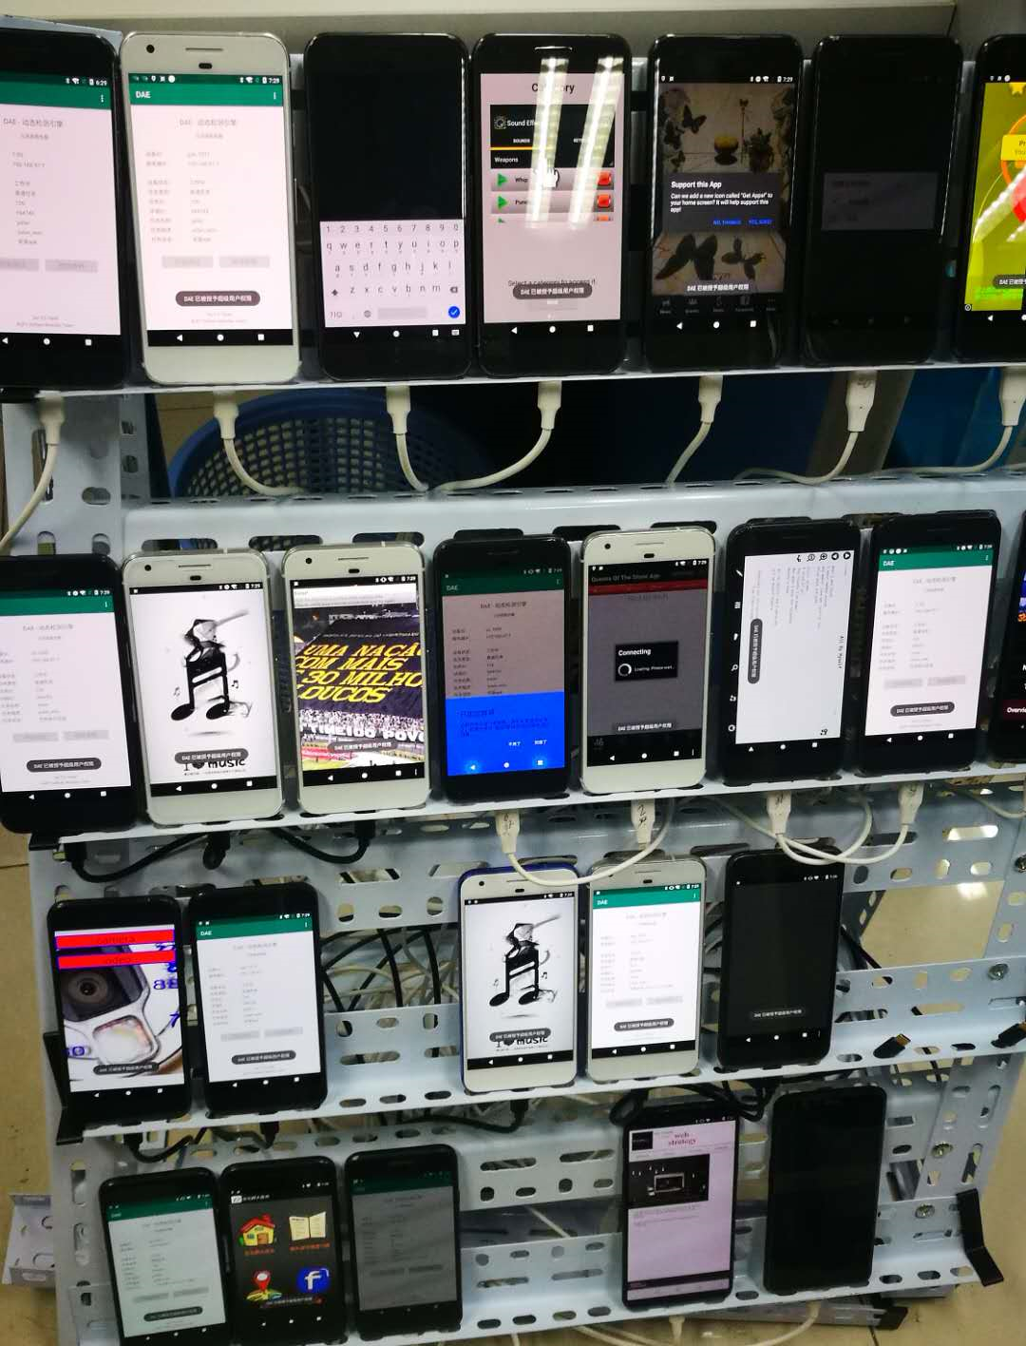


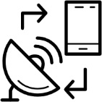

Characterizing Gambling Apps
1.Network Infrastructure
Data Collection
DroidBot
Screencap
TCPDUMP
UI Structure
NETSTAT
Gambling Apps
Traffic Data
Real Device
Domain List
(11,320 domains)
Notes:
So, we must collect all the network traffic of gambling apps.
To be specific, we use DroidBot running on real devices to do that. We used tcpdump to record the network traffic and netstat to distinguish the traffic from other apps. We also record the screencap and UI information.
After that, we filtered the domains with a domain list from common Android apps.
Finally, we got over 10k domains.

Slide 15
Characterizing Gambling Apps
1.Network Infrastructure
TLDs used in gambling apps
TLD&SLD | Category | TLD Manager | Count | Percentage
com | gTLD | VeriSign Global Registry Services | 8368 | 73.51%
xyz | New gTLD | XYZ.COM LLC | 1977 | 17.37%
cn | ccTLD | China Internet Network Information Center (CNNIC) | 307 | 2.70%
net | gTLD | VeriSign Global Registry Services | 203 | 1.78%
vip | New gTLD | Minds + Machines Group Limited | 97 | 0.85%
cc | ccTLD | eNIC Cocos (Keeling) Islands Pty. Ltd. d/b/a Island Internet Services | 93 | 0.82%
me | ccTLD | Government of Montenegro | 49 | 0.43%
Traditional gTLDs are popular, but gambling apps also use new gTLDs and ccTLDs
Notes:
Based on these data, we can characterize the network infrastructure.
At first, we observe the top-level domains.
You can see that most gambling apps rely on traditional generic TLDs such as .com and .net. They are the most popular.
However, for low price and loose regulation, many gambling apps also choose new generic TLDs such as .xyz, .app and special country code TLDs like .cc and .me.

Slide 16
Characterizing Gambling Apps
1.Network Infrastructure
ASNs of gambling app servers
Data source: Qihoo passive DNS, VirusTotal, IP-to-ASN
ASN | ASN_CN | ASN_DESC | IP COUNT | Percentage
4837 | CN | CHINA169-BACKBONE CNCGROUP China169 Backbone | 2134 | 15.32%
59371 | HK | DNC-AS Dimension Network & Communication Limited | 1392 | 9.99%
45102 | CN | CNNIC-ALIBABA-US-NET-AP Alibaba (US) Technology Co., Ltd. | 1239 | 8.89%
4808 | CN | CHINA169-BJ China Unicom Beijing Province Network | 879 | 6.31%
37963 | CN | CNNIC-ALIBABA-CN-NET-AP Hangzhou Alibaba Advertising Co.,Ltd. | 479 | 3.44%
13335 | US | CLOUDFLARENET - Cloudflare, Inc. | 318 | 2.28%
45753 | HK | NETSEC-HK NETSEC NOC | 294 | 2.11%
Over 40% in mainland China, over 50% of the gambling server addresses are outside mainland China
Notes:
The next is IP addresses.
We used Qihoo passive DNS and VirusTotal to collect IP addresses, then we used IP-to-ASN mapping tables to get the ASNs.
As these illegal gambling apps target Chinese users, over forty percent of IPs are in mainland China. This result partly suggests the ineffectiveness of gambling service regulation.
Besides, over 50% of the Ips are outside mainland China——some regions have less regulation on gambling services.

Slide 17
Characterizing Gambling Apps
1.Network Infrastructure
Registrars and Registrant emails of gambling app servers
Registrar | Count | Percentage
GoDaddy.com, LLC | 3896 | 34.42%
Alibaba Cloud Computing (Beijing) Co., Ltd. | 612 | 5.41%
Name.com, Inc. | 400 | 3.53%
eName Technology Co., Ltd. | 214 | 1.89%
XINNET TECHNOLOGY CORPORATION | 151 | 1.33%
MAFF Inc. | 149 | 1.32%
Registrant Email | Count | Percentage
abuse@godaddy.com | 3842 | 54.18%
DomainAbuse@service.aliyun.com | 728 | 10.27%
abuse@name.com | 407 | 5.74%
abuse@ename.com | 214 | 3.02%
search-apnic-not-arin@apnic.net | 182 | 2.57%
supervision@xinnet.com | 154 | 2.17%
The most popular registrar is GoDaddy.com; many Chinese registrars are also favored.
Almost all the registrant emails have enabled privacy settings
Notes:
We next analyze the domains registrants and registrars by the WHOIS records.
As for registrars, although the most popular registrar is GoDaddy.com, many Chinese registrars (like Alibaba) are favored.
About the registrant emails. Almost all of them have privacy settings. So, we cannot get any useful information.

Slide 18
Characterizing Gambling Apps
2. Malicious Behaviors
Malicious gambling apps
We used VirusTotal to detect malwares, and AVClass to assign their family.
Package Name | Version | #AV Engines | Family
yyc.app.web | 3.4.1 | 20 | boogr
wt.nc | 2.4 | 18 | -
com.pkrss.pkstock | 1.01 | 17 | cnzz
org.haotan.abyl | 1 | 12 | hypay
com.hulk.example.xinpuj190303 | 1 | 12 | jiagu
com.rb.android.XPJ04 | 1 | 11 | -
com.pack.hongbaoshi824 | 2 | 11 | jiagu
Some gambling apps are malwares, but the percentage is not high
Notes:
The next character is malicious purposes.
We used VirusTotal to identify potential malicious gambling apps and AVClass to assign a malware family name.
As we can see in the first line of this table, this gambling app is a malware reported by 20 anti-virus engines, which belongs to the boogr family.
In fact, some gambling apps can also serve for malicious purposes, but the percentage is not high.

Slide 19


Characterizing Gambling Apps
3. Third-party Services
Abused third-party domains
Third-party Domain | Apps
cfg.imtt.qq.com | 1269
log.tbs.qq.com | 1266
tbs.imtt.qq.com | 1048
s.jpush.cn | 923
ali-stats.jpush.cn | 819
openinstall.io | 679
play.googleapis.com | 639
Gambling
Apps
Domains
Domains
Filtering
Third-party domain list
Many development services are abused by gambling apps
Notes:
We also analyze third-party services abused.
The first is third-party domains. We use domains of apps from app markets and the Alexa top list to build the third-party domain list, so we can used it to find third-party domains.
We manually labeled third-party domains used by illegal gambling apps. And we found that many development services are used, such as bug collection, third-party push notification services.

Slide 20
Characterizing Gambling Apps
3. Third-party Services
Abused third-party libraries
Third-party Library | Apps
Lokhttp3 | 3853
Lokio | 3731
Lcom/google/gson | 3396
Lcom/tencent | 2875
Lcom/bumptech/glide | 2869
Lcn/jpush/android | 2055
Lcn/jiguang | 2026
Gambling
Apps
LibRadar
Gambling apps also use many development-aid libraries
Notes:
Secondly, we used LibRadar to identify the third-party libraries in gambling apps. As expected, development-aid libraries are also widely used, which could make development easier.

Slide 21
Characterizing Gambling Apps
3. Third-party Services
Abused CNAMEs
CNAMEs | Domains
yb550.com | 1781
yb559.com | 761
lxwaf.com | 602
cdngslb.com | 470
cdn-discuz.com | 400
ppbk4.com | 312
c3-anti-ddos.com | 264
Gambling
Apps
WAF
Domains
Passive DNS
CDN
Anti-DDos
Gambling apps use many kinds of third-party services by CNAMEs
Notes:
CNAMEs used by gambling apps make it difficult for us to analyze the real servers. We used Qihoo passive DNS to collect the CNAME of gambling app domains. Then we inferred the purposes of them from their names. You can see WAF, CDN and Anti-Ddos. But there are also some domains we can not know their functions from their meaningless names.
In a word, gambling apps use many kinds of third-party services by CNAMEs.

Slide 22
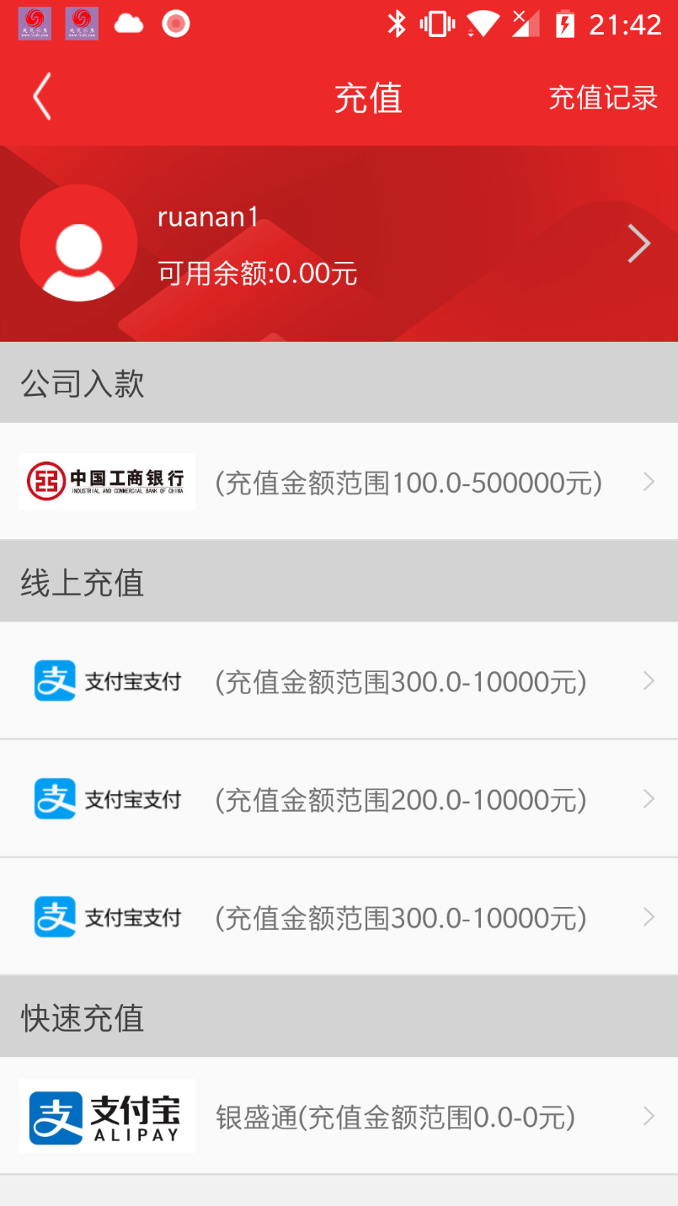

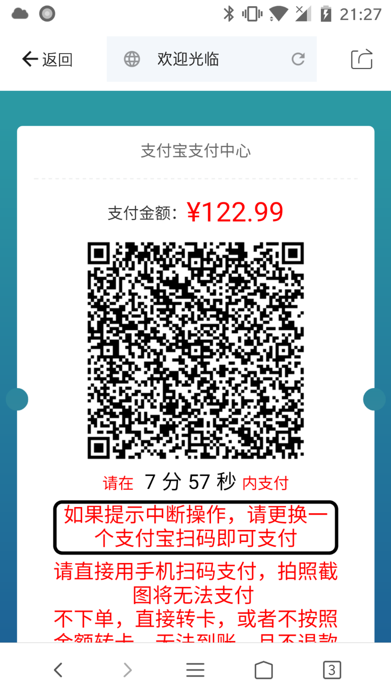
Characterizing Gambling Apps
4. Payment Services
Fourth-party payment service
Fourth-party payment services, based on third-party payment services, are widely used in gambling apps.
Notes:
Finally, we analysis the payment service, which is one of the most essential part.
To evade supervision, illegal gambling apps usually choose hidden payment channels, the Fourth-party payment service.
In one gambling app, users can choose one from many fourth-party payment services. These services have their own payment page, which are based on traditional 3rd-party payment services like Alipay.

Slide 23
Characterizing Gambling Apps
4. Payment Services
Traditional payment service VS. fourth-party payment service
Traditional payment service
Fourth-party payment service
By using virtual merchant accounts, fourth-party payment services make the money flow difficult to track
Notes:
These fourth-party payment service are based on traditional 3rd-party payment services but different.
In 3rd-party payment services, users will pay money directly to the merchant.
But the fourth-party services provides many virtual merchant accounts. Users also pay money through 3rd-party payment services, but the merchants are not the gambling websites, but some virtual merchants. So, the money flows are difficult to track.

Slide 24
Characterizing Gambling Apps
4. Payment Services
Fourth-party payment services in 10 apps
44 fourth-party payment platforms in total
Fourth-party payment services | Alipay | WechatPay | UnionPay | EBank | QQPay | JDPay
henuser.ulan.com.cn | Y | Y
www.wantong-pay.com | Y | Y
www.777zhifu.com | Y
newapi.xfuoo.com | Y | Y | Y | Y
api.zfth666.com | Y |  | Y
show.wiipay.cn |  |  |  |  | Y
dianfeng789.top |  |  |  |  |  | Y
One gambling app usually use several fourth-party payment services
Fourth-party payment services provides many payment methods based on third-party payment services
Notes:
To analyze the fourth-party payment used by gambling apps, we manual analyzed 10 gambling apps.
Surprisingly, these ten apps have used, in total, 44 fourth-party payment platforms. They often provide different payment methods based on traditional third-party payment platforms, such as Alipay, Wechat Pay, UnionPay, EBank, QQPay, and JDPay.

Slide 25


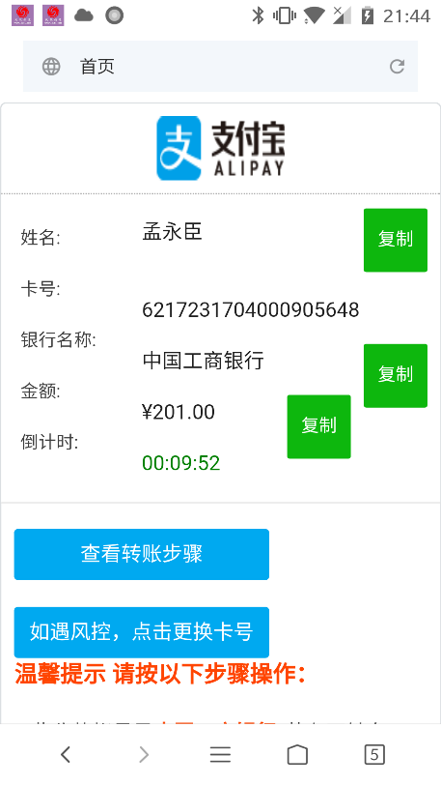
Characterizing Gambling Apps
4. Payment Services
Payment accounts from platforms
Place orders but not make actual payments
Payment Platform | Order Count | Account Count
decimal25.com | 2176 | 193
buyibk.cn | 1103 | 723
luchengpay.com | 531 | 86
huahaiteng.com | 210 | 40
dianfeng789.top | 57 | 6
Total | 4077 | 1048
Fourth-party payment services use many virtual merchant accounts
Notes:
By placing orders but not making actual payments, we could automatically collect the virtual payment accounts.
As you can see, every platform uses many accounts to collect payments.

Slide 26
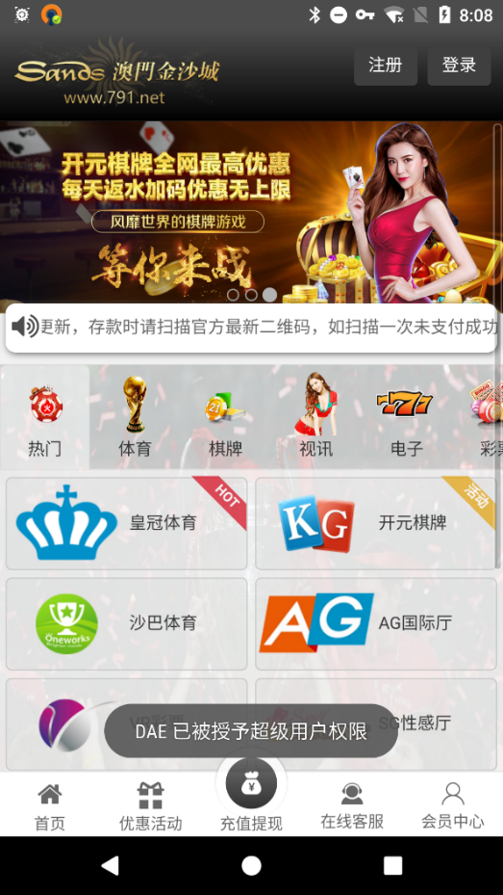
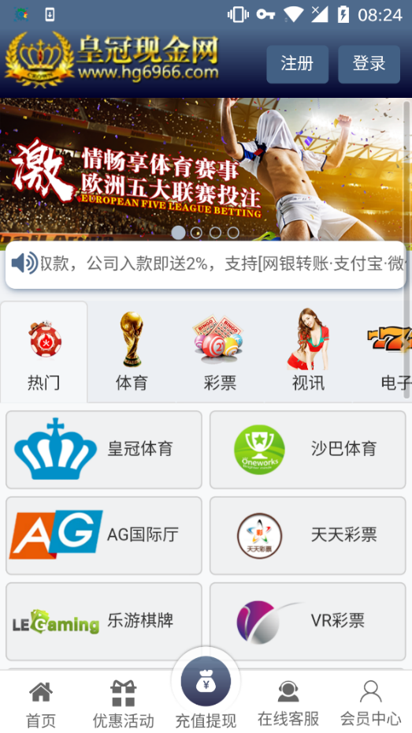
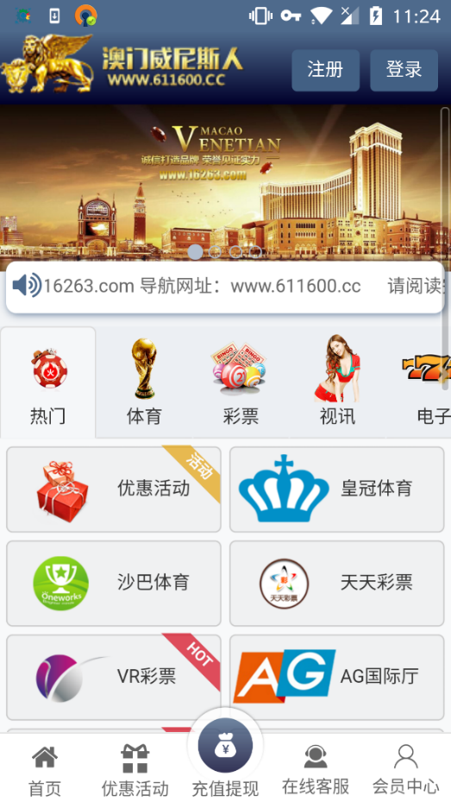
Inferring new Gambling Apps
App Clustering
Gambling apps with similar UI structures
Are gambling apps having similar UI operated by the same group?
Can we find more gambling apps by analyzing their relationships?
Notes:
In our preliminary research, we found that many gambling apps have similar UI structures. For example, these three gambling apps are almost identical.
Thus, we wondered whether they are operated by the same groups and created by templates, and can we find more gambling apps by analyzing their relationships?

Slide 27
Inferring new Gambling Apps
App Clustering
Gambling app clusters
FSquaDRA2
DBSCAN
3,048 gambling apps, 193 groups, 318 apps isolated
Fourth-party payment services use many virtual merchant accounts
Notes:
To analyze the code-level similarities between apps, we used FSquaDRA2 to make pairwise comparisons between all apps. Then, we used DBSCAN algorithm to cluster them.
Finally, over 3k gambling apps can be clustered into about 190 groups. This result suggests that gambling apps are usually operated in groups indeed.

Slide 28


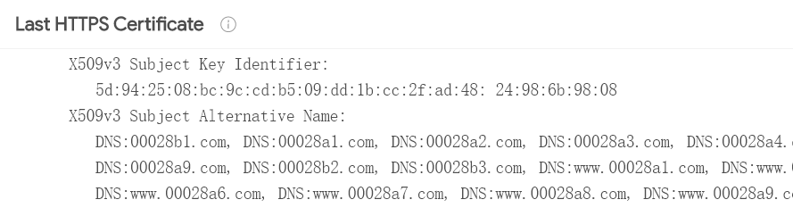

Inferring new Gambling Apps
Identifying New Gambling Apps
Based on HTTPS certificates
Based on app developer signatures
Guilt-by-association
Koodous
Gambling
Apps
Developer Signatures
Filtering
new apps
HTTPS Certs
Domains
new domain names
Common Keys
Based on HTTPS certifications and app developer signatures, we found over 140k new domains and over 41k new apps. Most of them are gambling services and apps.
We also found some malicious apps.
Notes:
Then we propose a ”guilt-by-association” expansion method to identify new gambling services and apps .
We firstly discover more gambling services based on the Subject Alternative Name in HTTPS certifications. By collecting HTTPS certifications using VirusTotal, we found many new domains just like it’s shown in this figure.
Then we analyzed app developer signatures. Removing the common keys like the test key from the AOSP project, we got over 1k private signatures. And we used them to search on Koodous which is an mobile app database allowing to search by developer signatures.
Using these two methods, we found over 140k new domains and over 41k new apps. By manually verifying, most of them are gambling services and apps. And there are also some malicious apps.

Slide 29
Conclusion and Take Away Messages
Although online gambling is illegal in China, we indeed observe a number of gambling servers deployed in mainland China, which suggests the ineffectiveness of gambling regulation.
Hidden fourth-party payment services are widely used in gambling apps to hide the identities of money recipients.
The “guilt-by-association” method are useful to identify new suspicious gambling services and apps, which could guide us to raise alarms when new related services/apps are found.
We have released our dataset at:
https://mobile-app-research.github.io/
Notes:
In conclusion, our work suggests that:
By the way, we have released our dataset at our website.

Slide 30
Thanks!
Any kind of collaboration is welcome.
gyh@bupt.edu.cn
haoyuwang@bupt.edu.cn
Notes:
Thanks for your listening. Any kind of collaboration is welcome.
Feel free to contact me or my advisor Haoyu Wang at Beijing University of Posts and Telecommunications.
Here’s our Contact information.

